Slide 1
Beaconsfield Cycle Paths Action Group
High March School
8th February 2012
"When I see an adult on a bicycle ...I do not despair for the future of the human race,"
H.G. Wells

Slide 2
Agenda
Welcome
Introduction
Feedback from schools – cluster analysis
Footpath and map analysis
Summary
Next Steps

Slide 3

The Times has launched a public campaign and 8-point manifesto calling for cities to be made fit for cyclists including:
Two per cent of the Highways Agency budget should be earmarked for next generation cycle routes, providing £100 million a year towards world-class cycling infrastructure. Each year cities should be graded on the quality of cycling provision.
Businesses should be invited to sponsor cycle ways and cycling super-highways, mirroring the Barclays-backed bicycle hire scheme in London.
Every city, even those without an elected mayor, should appoint a cycling commissioner to push home reforms.

Slide 4
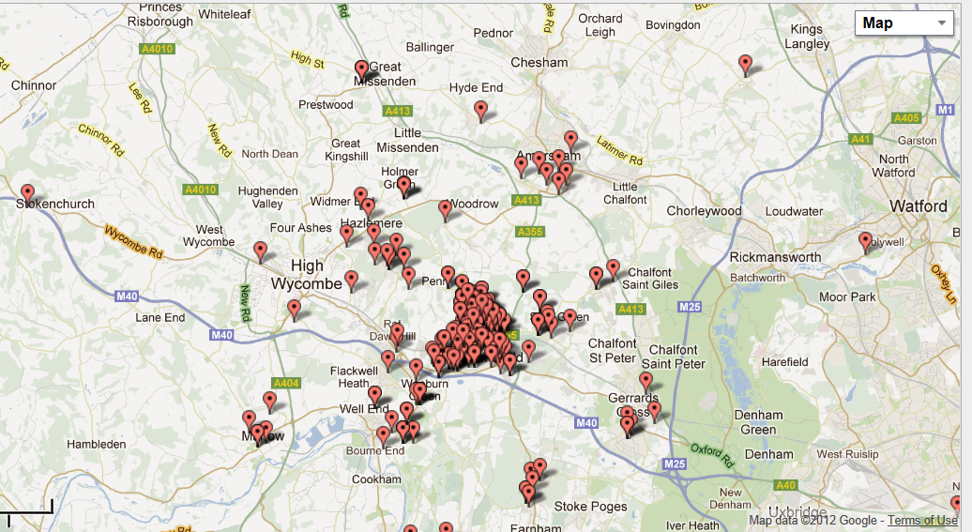
High March Cluster Analysis
www.batchgeo.com

Slide 5
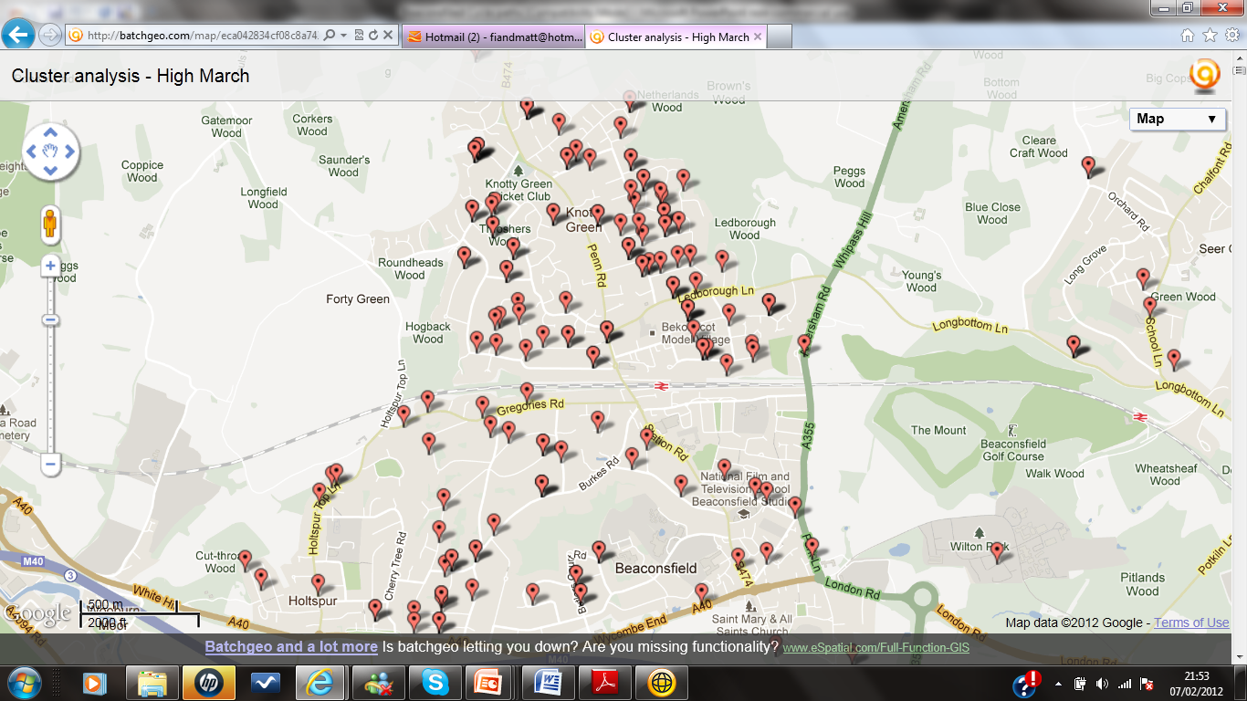
www.batchgeo.com

Slide 6
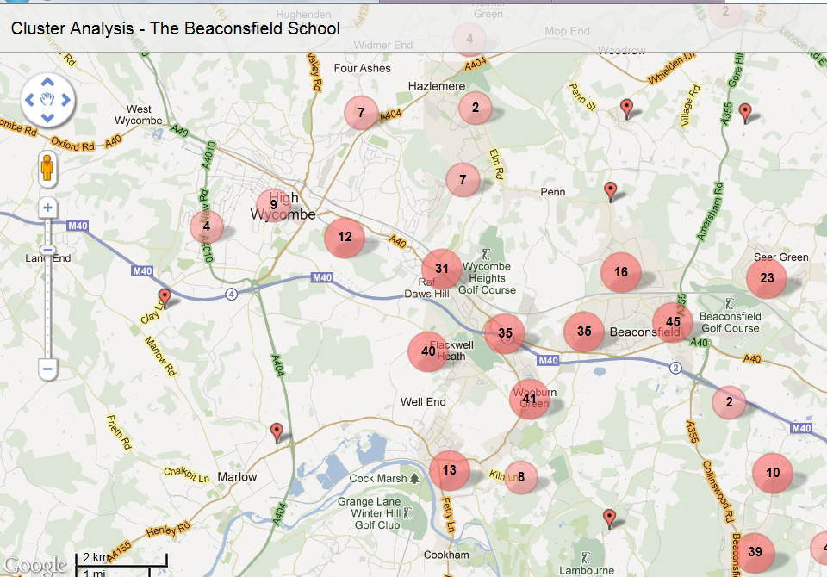
DRAFT – work in progress

Slide 7
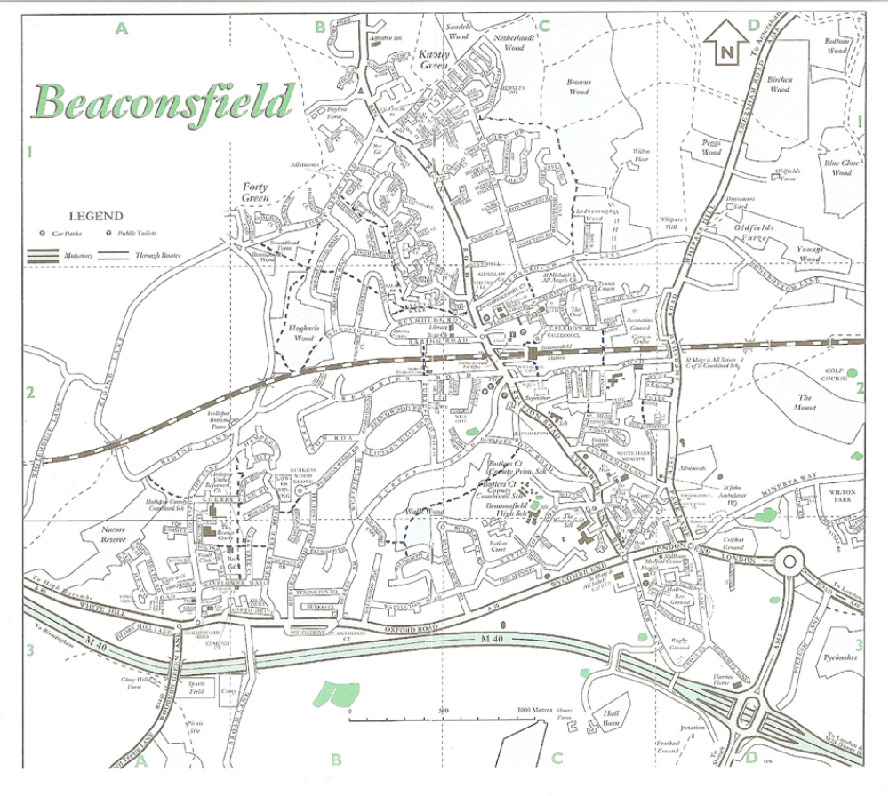
Cross Town Link

Slide 8
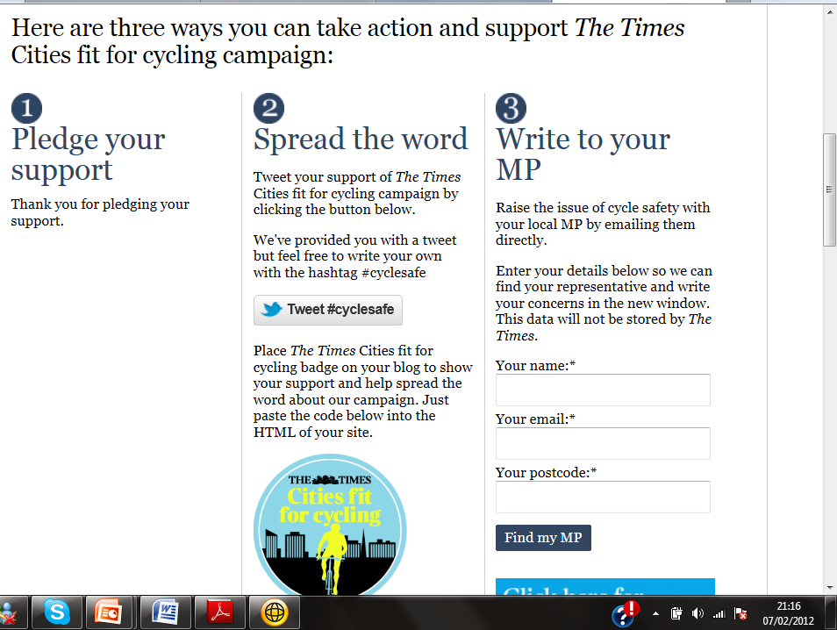

Slide 9
AOB
Bike rack audit
Access to stations letter from Bucks Chamber of Commerce

